Slide 1


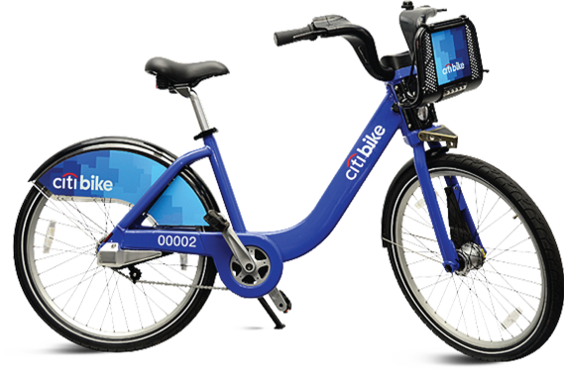

May 2020 Citi Bike Trip Data
Hemin Patel
Data 101 HW 3

Slide 2
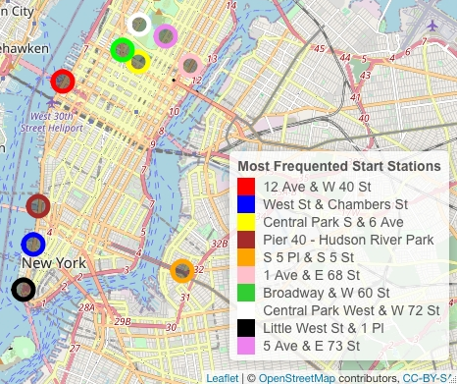
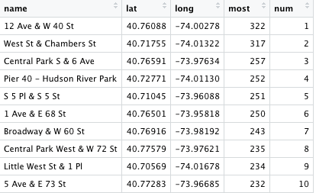
Top 10 Popular Citi Bike Start Locations
The most frequented location is located on 12 Ave & W 40 St
Populous Citi Bike locations are around Central Park
Many of the unpopular locations are located in the other boroughs Ex: Bronx, Queens, etc.
Since Manhattan is lively, according to the data, Citi Bike should advertise more in this region, especially Midtown.
Interactive Map
Location Count
Notes:
#Popular locations
Start_Count <- table(Citi_Bike$start.station.name)
View(Start_Count)
library(leaflet)
library(sp)
data <- read.csv("/Users/hemin/Desktop/Data 101/HW 3/Start.csv")
View(data)
data$long <- as.numeric(data$long)
data$lat <- as.numeric(data$lat)
data.SP <- SpatialPointsDataFrame (data[,c(2,3)], data[,-c (2,3)])
data$num = cut(data$most,
breaks= c(322, 317, 257, 252, 251, 250, 243, 235, 234, 232), right=FALSE,
labels= c("1","2", "3", "4", "5", "6", "7", "8", "9", "10"))
pal= colorFactor(palette = c("red", "blue", "yellow", "brown", "orange", "pink", "green", "white", "black", "violet"), domain=data$num)
Chart <- leaflet() %>%
addTiles() %>%
setView(-74.00, 40.71, zoom = 12) %>%
addCircleMarkers(data=data, lng= ~long, lat= ~lat, popup= ~name, color= ~pal(num), opacity= 100, fillColor = "black", fillOpacity = 0.4) %>%
addLegend(
position = "bottomright",
colors = c("red", "blue", "yellow", "brown", "orange", "pink", "limegreen", "white", "black", "violet"),
labels = c("12 Ave & W 40 St", "West St & Chambers St", "Central Park S & 6 Ave", "Pier 40 - Hudson River Park", "S 5 Pl & S 5 St", "1 Ave & E 68 St","
Broadway & W 60 St", "Central Park West & W 72 St", "Little West St & 1 Pl", "5 Ave & E 73 St"),
title = "Most Frequented Start Stations",
opacity=100)
Chart

Slide 3
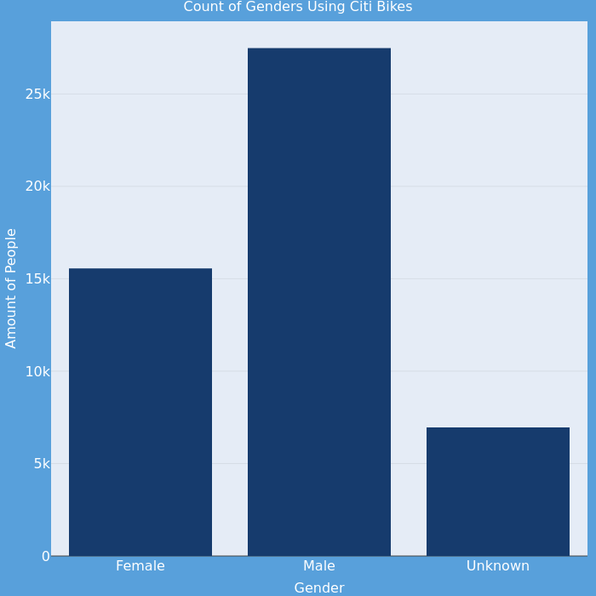
Count of Genders Using Citi Bikes
There are predominately more males that use the Citi Bikes rather than females.
A difference of 11,929 males
Citi Bike is aware of these statistics and launched Women's Bike Month during the month of October
Offering all new riders their first trip for free and donating $1 from each ride to Girl Up's SchoolCycle program
Interactive Graph
Gender | User Types
Females | 15555
Males | 27484
Unknown | 6961
Notes:
#Genders
M_F <- aggregate(usertype ~ gender, data= Citi_Bike, FUN = length)
write.csv(M_F,'M_F.csv')
M_F1 <- read.csv("~/Desktop/Data 101/HW 3/M_F.csv")
library(plotly)
t <- list(
family = "sans serif",
size= 16,
color = 'white')
fig <- plot_ly(x = c(M_F1$gender), y = c(M_F1$usertype), width = 700, height = 700, type = 'bar', marker = list(color = '#003B70')) %>%
layout(title= list(text = "Count of Genders Using Citi Bikes",font = t), font=t,
xaxis = list(title = list(text ='Gender', font = t)),
yaxis = list(title = list(text ='Amount of People', font = t)),
plot_bgcolor='#e5ecf6', paper_bgcolor='#58A0DB')
# api_create(p=fig, filename = "Count of Genders Using Citi Bikes")
fig

Slide 4
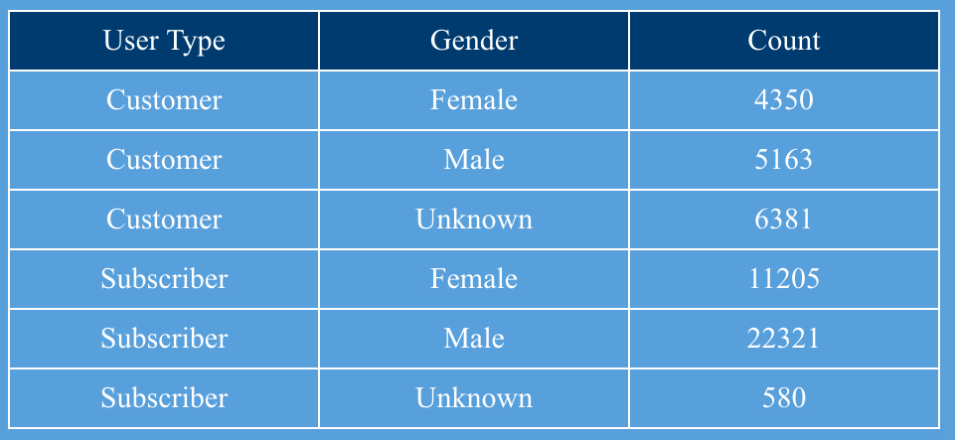
Count of User Types' Gender
As previously mentioned, there are more male users. Additionally, more males are also subscribers. With this assumption, we can conclude that they are active users of Citi Bike.
Moreover, more females are subscribers rather than customers.
There is almost roughly no difference in customer’s gender
Only 187 more males used Citi Bikes as a customer
Overall, there are more subscribers than customers
User Types | Count
Customer | 15894
Subscriber | 34106
Notes:
#Count of User Types' Gender
library(dplyr)
library(plotly)
M_F_User <- Citi_Bike %>%
count(usertype, gender, sort= FALSE)
colnames(M_F_User) <- c("User Type", "Gender", "Count")
fig <- plot_ly(
type='table',
header=list(
values=names(M_F_User),
align = c("center", "center"),
line = list(width = 1, color = 'white'),
fill= list(color= c("#003B70", "#003B70")),
font= list(family = "San Serif", size =15, color = "white"),
height= 30),
cells=list(
values=unname(M_F_User),
align = c("center", "center"),
line = list(width = 1, color = 'white'),
fill= list(color= c("#58A0DB", "#58A0DB")),
font= list(family = "San Serif", size =15, color = "white"),
height= 30)) %>%
layout(paper_bgcolor='#58A0DB')
# api_create(p=fig, filename = "Count of Customers & Their Genders")
fig
# ------------------------------------------------

Slide 5
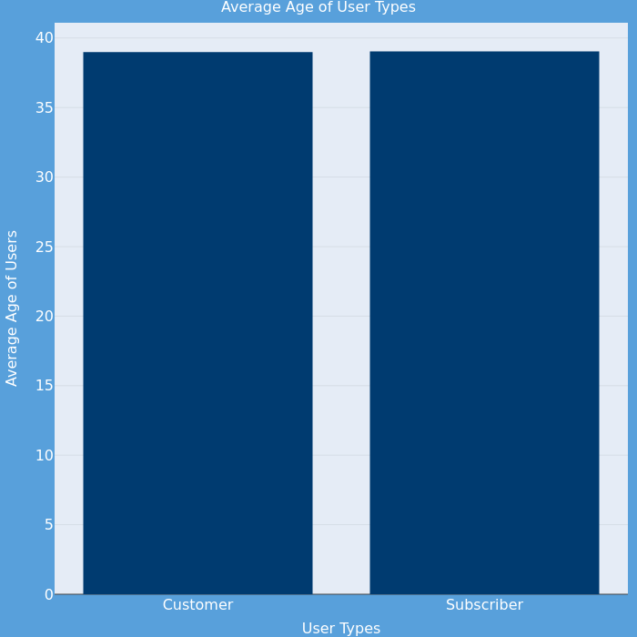
Average Approximate Age of User Types
The average age for both customers and subscribers is remotely the same.
Customer: 38.98
Subscriber: 39.04
It is apparent that more mature individuals partake in riding Citi Bikes
Interactive Graph
User Types | Median Age
Customer | 37
Subscriber | 36
User Types | Min Age
Customer | 16
Subscriber | 16
User Types | Max Age
Customer | 120*
Subscriber | 135*
*The data for Max-Age may be incorrect as the birth year is set to 1885 and 1990. Either by the user or a bug-related software issue.
Notes:
#Avg Age of User Types
agealc <- function(birth.year, current){
require(Citi_Bike.table)
y <- year(current) - year(birth.year) -1
age <- y
return (age)
}
k <- aggregate(Age ~ usertype, data= Citi_Bike, FUN = mean) #Grader Notes: replaced "mean" for "median," "min," and "max" to calculate those values.
write.csv(k, 'Age_User.csv')
Age_User <- read.csv("~/Desktop/Data 101/HW 3/Age_User.csv")
t <- list(
family = "sans serif",
size= 16,
color = 'white')
fig <- plot_ly(x = c(Age_User$usertype), y = c(Age_User$Age), width = 700, height = 700, type = 'bar', marker = list(color = '#003B70')) %>%
layout(title= list(text = "Average Age of User Types",font = t), font=t,
xaxis = list(title = list(text ='User Types', font = t)),
yaxis = list(title = list(text ='Average Age of Users', font = t)),
plot_bgcolor='#e5ecf6', paper_bgcolor='#58A0DB')
# api_create(p=fig, filename = "Average Age of User Types")
fig
#--------------------------------------------
#Sub & Cust Count
Sub_Cust <- table(Citi_Bike$usertype)
View(Sub_Cust)
Sub_Cust1 <- write.csv(Sub_Cust, "Sub_Cust.csv")
data_nohead <- read.csv("Sub_Cust.csv", header = TRUE)
colnames(data_nohead) <- c(" ", "User Type", "Count")
View(data_nohead)

Slide 6
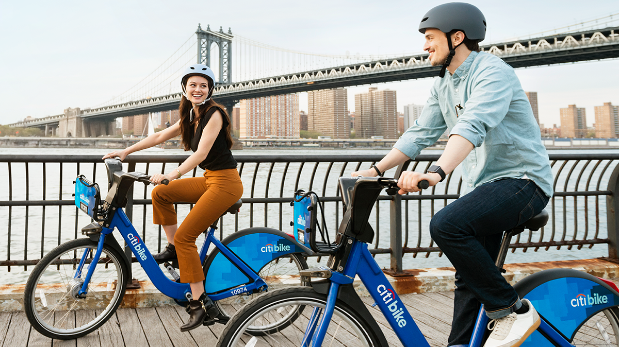
Notes:
#Avg Age of User Types
agealc <- function(birth.year, current){
require(Citi_Bike.table)
y <- year(current) - year(birth.year) -1
age <- y
return (age)
}
k <- aggregate(Age ~ usertype, data= Citi_Bike, FUN = mean)
write.csv(k, 'Age_User.csv')
Age_User <- read.csv("~/Desktop/Data 101/HW 3/Age_User.csv")
t <- list(
family = "sans serif",
size= 16,
color = 'white')
fig <- plot_ly(x = c(Age_User$usertype), y = c(Age_User$Age), width = 700, height = 700, type = 'bar', marker = list(color = '#003B70')) %>%
layout(title= list(text = "Average Age of User Types",font = t), font=t,
xaxis = list(title = list(text ='User Types', font = t)),
yaxis = list(title = list(text ='Average Age of Users', font = t)),
plot_bgcolor='#e5ecf6', paper_bgcolor='#58A0DB')
# api_create(p=fig, filename = "Average Age of User Types")
fig
#--------------------------------------------
#Sub & Cust Count
Sub_Cust <- table(Citi_Bike$usertype)
View(Sub_Cust)
Sub_Cust1 <- write.csv(Sub_Cust, "Sub_Cust.csv")
data_nohead <- read.csv("Sub_Cust.csv", header = TRUE)
colnames(data_nohead) <- c(" ", "User Type", "Count")
View(data_nohead)

